Slide 1
Detection of Potholes Using Smartphone Sensors
Instructor: Arjan Durresi
Prem Chand Avanigadda
2000275504
ADV MOBILITY & CLOUD COMPUTING

Slide 2
ABSTRACT
In this project, we implement a method to monitor potholes. Potholes may cause serious loss to the economy by causing major accidents, they stand in 18th position in causing road accidents. This smartphone application using sensors like accelerometer, which automatically detects potholes and store them in AWS DynamoDB using RestAPI.
Keywords: potholes, smartphone, accelerometer, AWS server, DynamoDB

Slide 3
Mobile app development
Hybrid mobile application
Easy to develop in less time and deployable to multiple platforms like IOS and android
Used IONIC platform, Cordova which uses angular.js and typescript
IONIC Native plugins
IONIC UI components

Slide 4
Plugins
Geolocation : To get latitude and longitude of the pothole
Sensors : To access mobile sensors like accelerometer and gyroscope.
Device : To get device information like UUID, platform
Advanced HTTP plugin : To make Restful API calls
cordova-plugin-ionic-keyboard, cordova-plugin-ionic-webview, Splashscreen, StatusBar, Whitelist etc

Slide 5
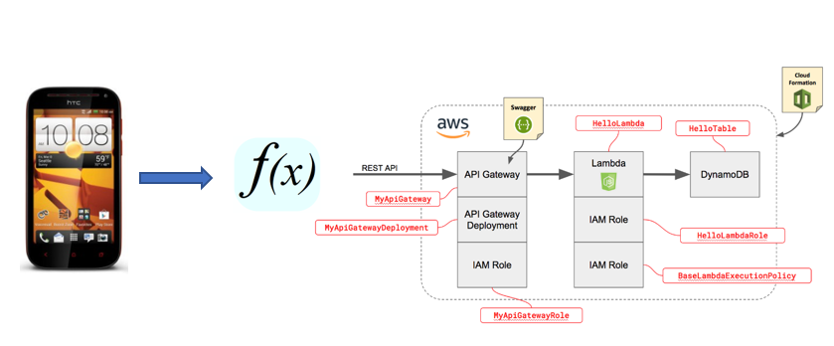
Procedure
Machine learning Model
Threshold Filters
Sensors

Slide 6
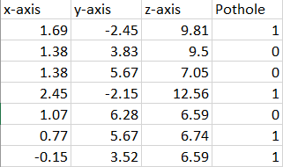
Machine learning model
Pothole sensor data is took from CRAWDAD group in Dartmouth
Preprocessed the data by extracting important features
Built classification tree model using sklearn python libraries
Accuracy of 96.6 %
Used pickle libraries to store the model.

Slide 7
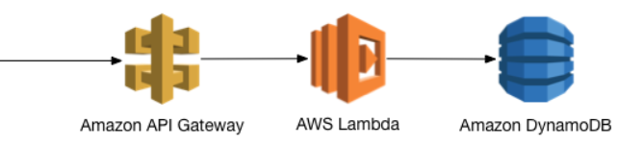
AWS services
Created Restful API with POST call and deployed in API Gateway
Every post call invokes the lambda function written in python.
We access the DynamoDB in lambda function to insert the pothole records

Slide 8
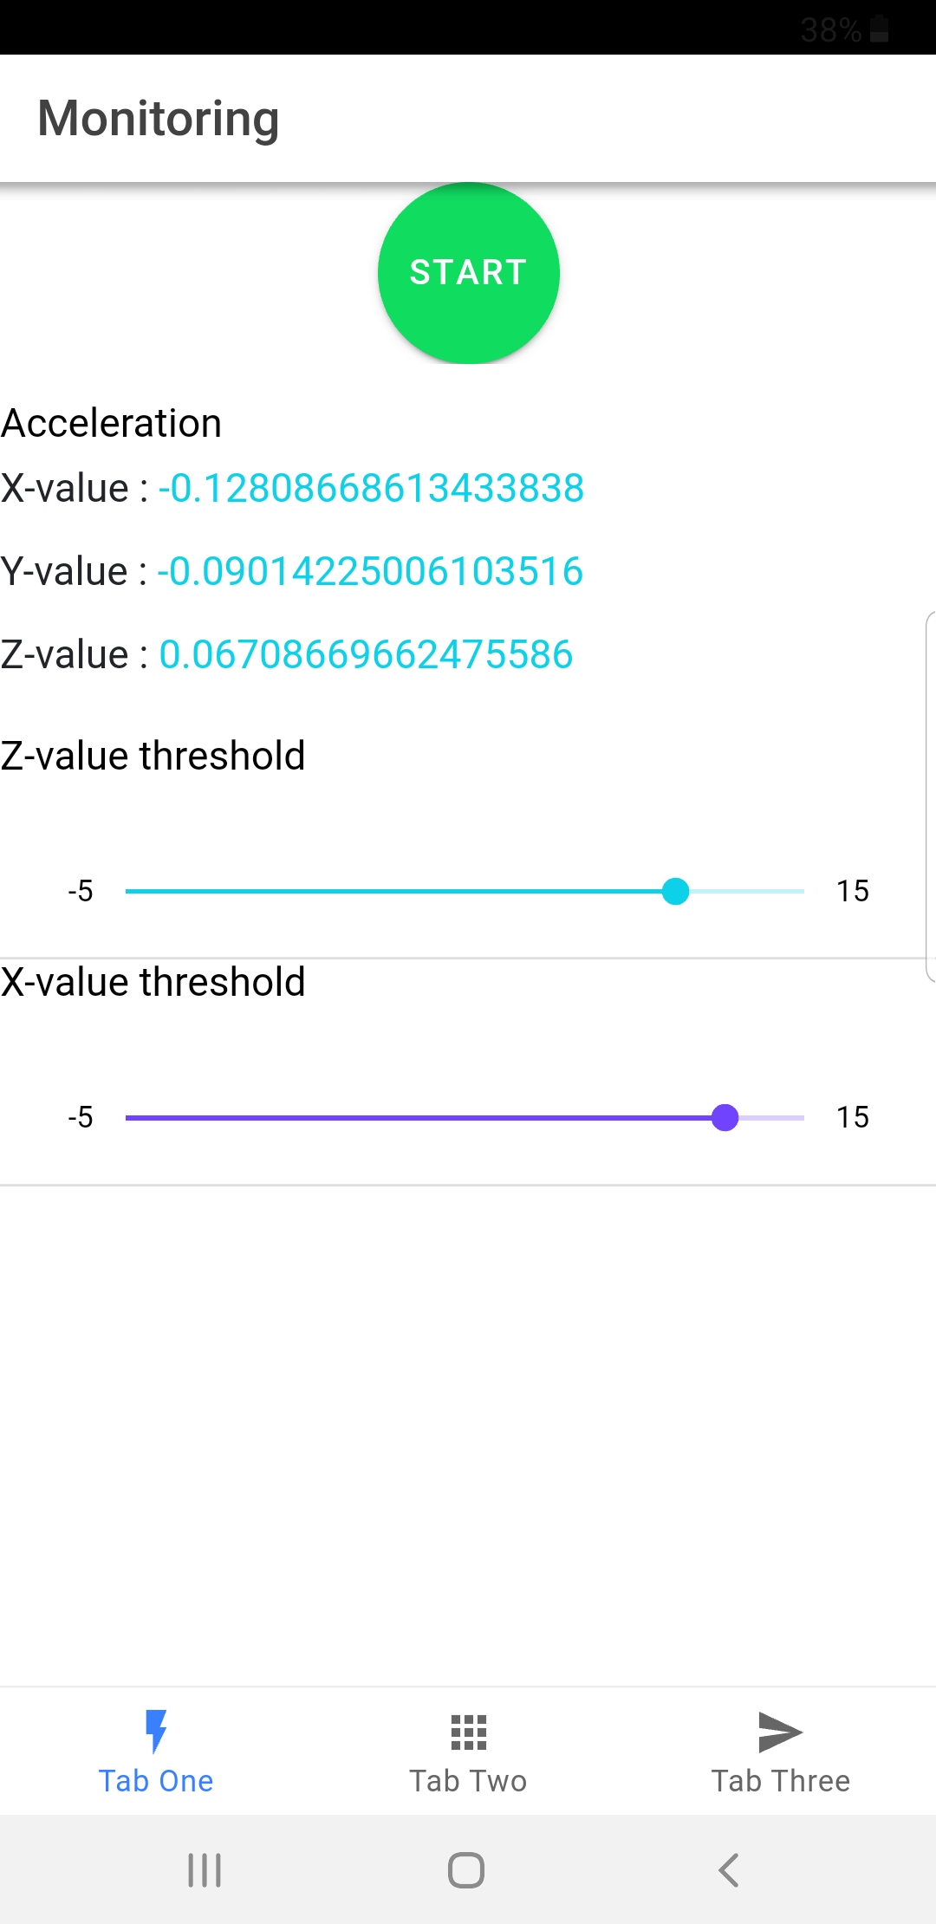
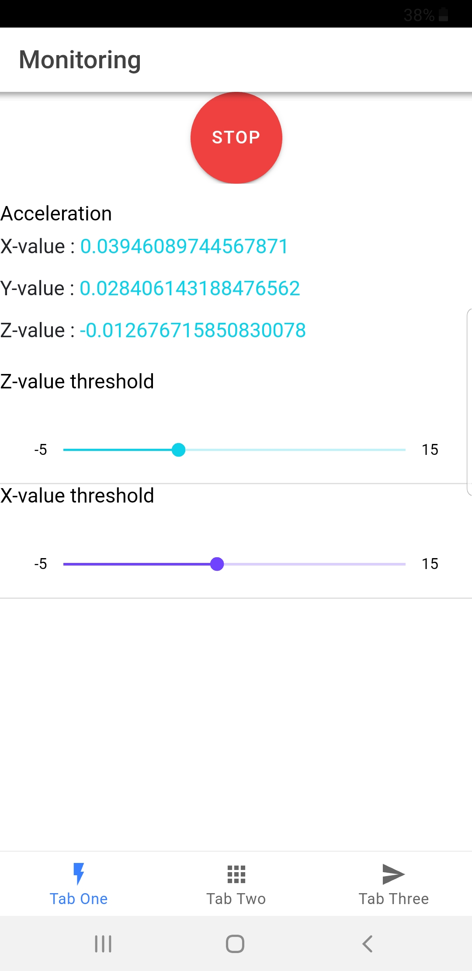
Results

Slide 9
Results – cont
API Gateway
Lambda function
DynamoDB

Slide 10
THANK YOU

